Slide 1
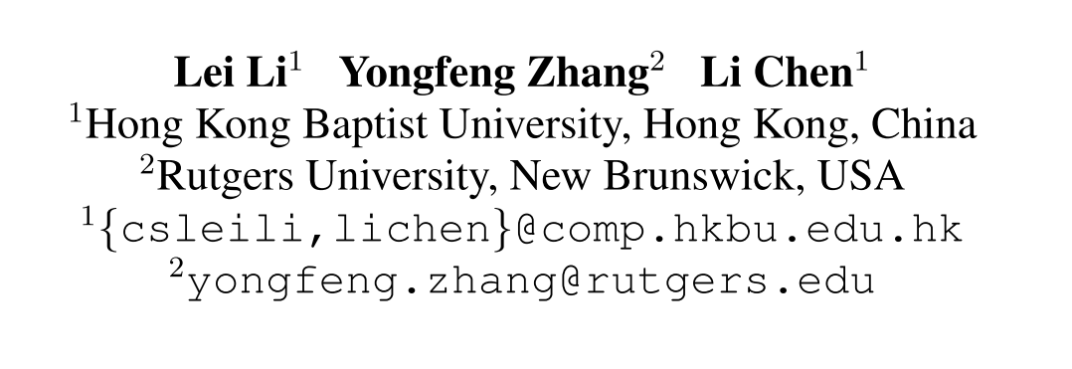
Chongqing University of Technology
ATAI
Advanced Technique of Artificial Intelligence
Chongqing University of Technology
Personalized Transformer for Explainable Recommendation（ACL 2021 ）
Code https://github.com/lileipisces/PETER
彭展望

Slide 2
Outline
Introduction
Related Work
Method
Experiment
Conclusion

Slide 3
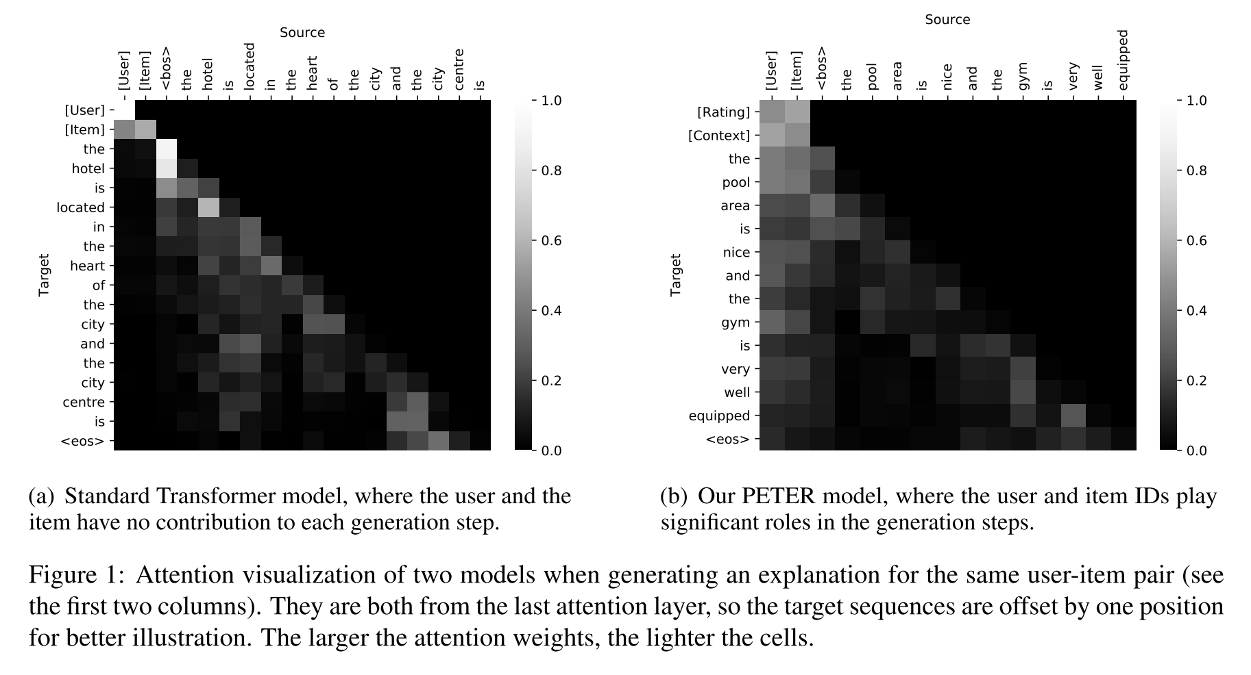
Introduction

Slide 4
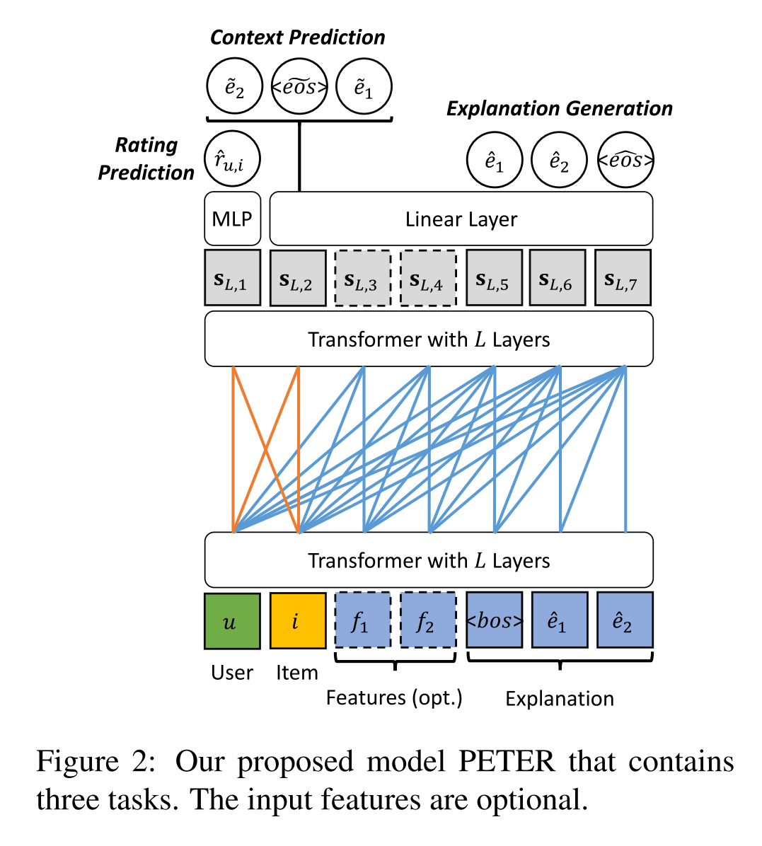
Method
Input:
positional representation:
S+positional representation:

Slide 5
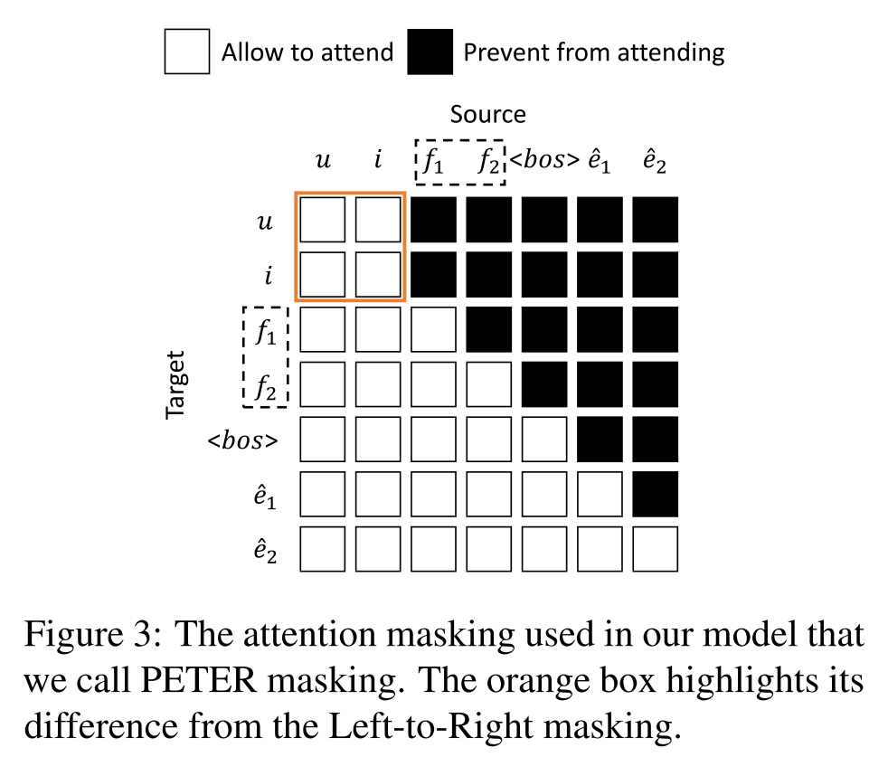
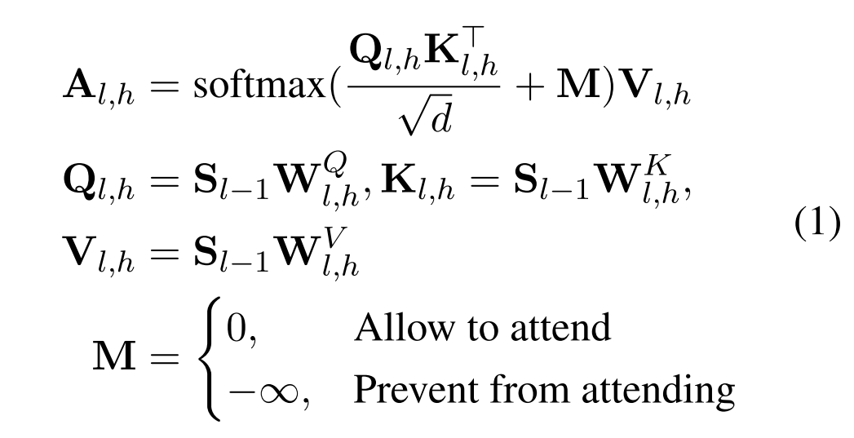
Method
Transformer and Attention Masking:

Slide 6
Method
Explanation and Recommendation:
Explanation Generation:

Slide 7
Method
Context Prediction:
Rating Prediction:

Slide 8
Method

Slide 9
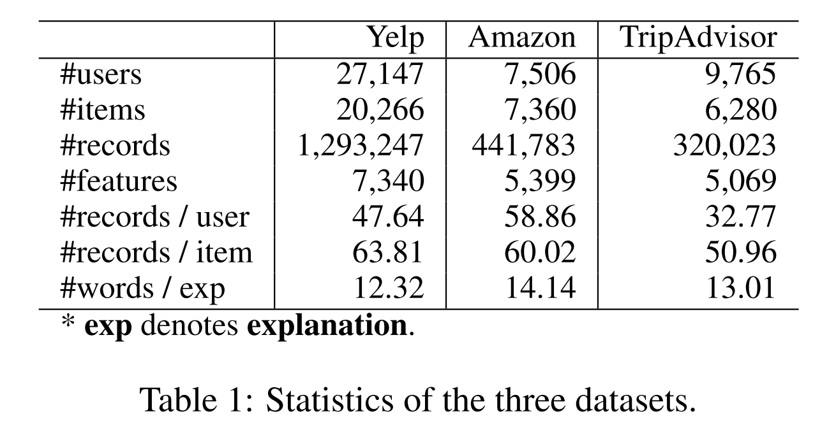
Dataset

Slide 10
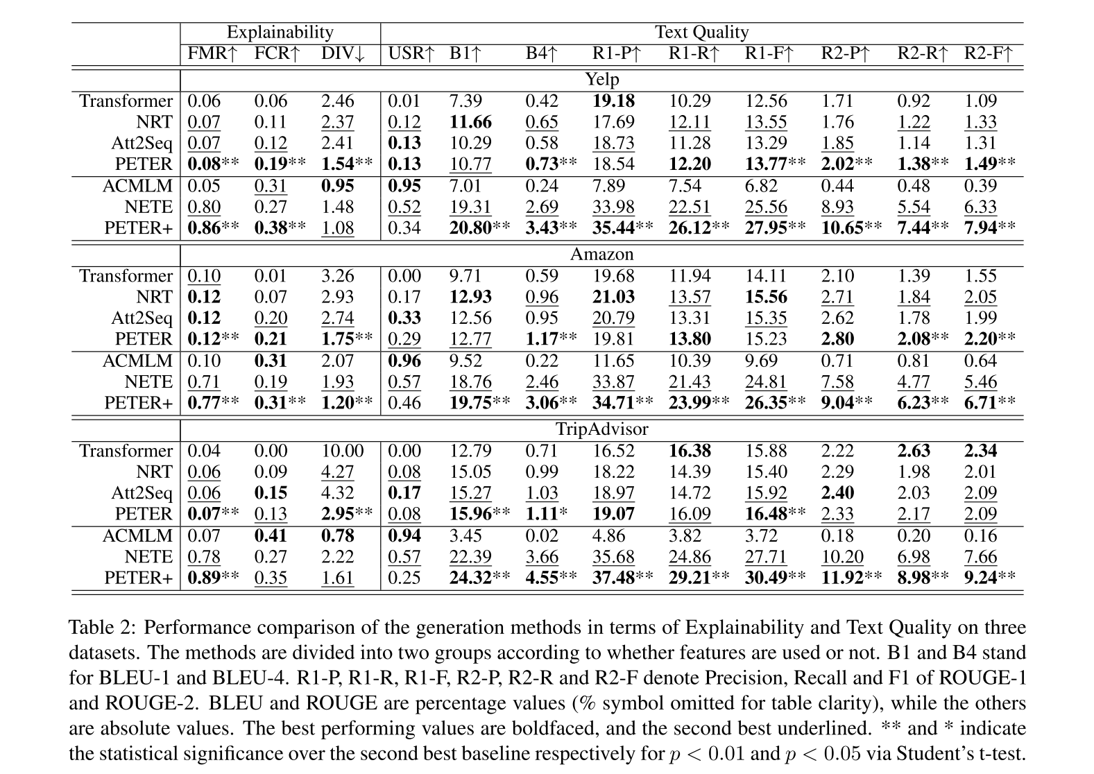

Slide 11
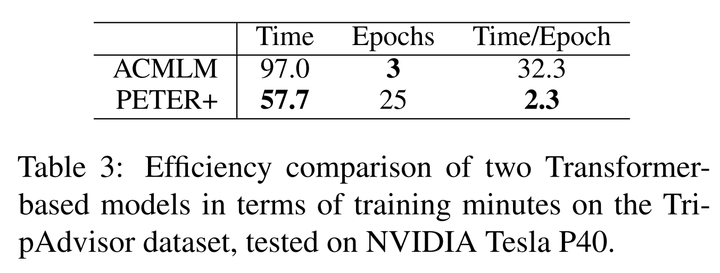
Experiment

Slide 12
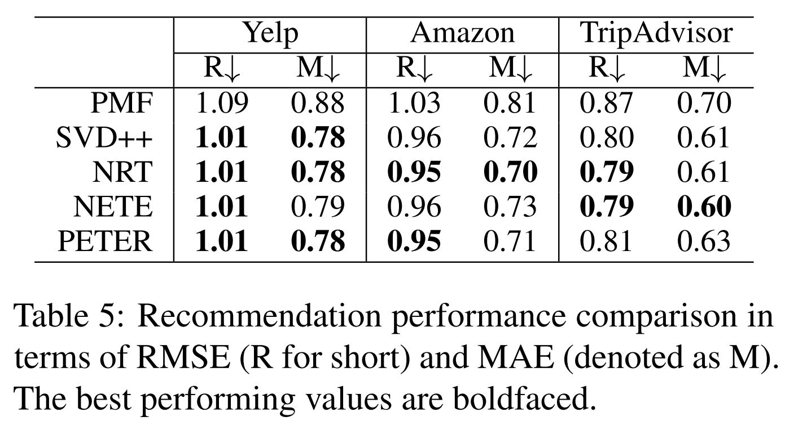
Experiment

Slide 13
Experiment

